Slide 1
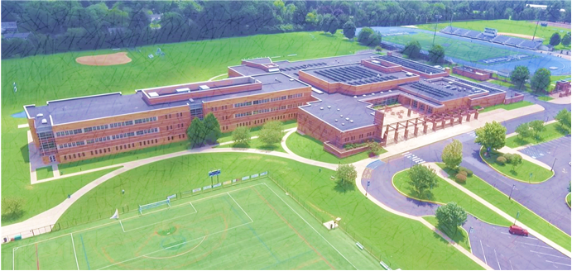
GVMS PTO General Meeting
3/2/23 6:30pm-7:30pm
Hybrid (Cafeteria and Zoom)

Slide 2
Welcome
Board Intros
01
MS Updates
Dr. Souders
02
PTO Updates
Alpa Jani
03
Sponsorship/Fundraisers
Christine Bradley
04
Budget Review
Tiana Threadgill
05
Questions/
Comments
06

Slide 3
2022-2023 Board Members
Tiana Threadgill: Advisor
Alpa Jani and Christine Bradley: Co-Presidents
Cristina Hartley: Vice President
Tiana Threadgill: Acting Treasurer
Bobbijo Pinnelli: Recording Secretary
Open Board Positions: 2 Co-Treasurers and Correspondence Secretary
**Approve minutes from last general board meeting

Slide 4
GVMS Updates
MS Updates and Information Sharing from Dr. Souders

Slide 5
PTO Updates
Field trip community sponsorship status
March Book Fair- volunteer opportunity
By-Law Update Review
PTO Ambassadors at upcoming events

Slide 6
GVMS PTO Sponsorship
Back to School Night Snacks
Snacks for Student Council October 7th & 8th Grade Dance
Spiritwear for Teachers
Custodial Staff Appreciation Gifts
December Bus Driver Appreciation
Student of the Month Treats
Beautification Committee Items
February District Wide Bus Driver Appreciation
Snacks for March Student Council 7th & 8th Grade Dance
GVHS After Prom Donation
Teacher Appreciation Gifts and Dinner
Electronic Translators for the School
Donation for GV teacher Jennifer Krasna that passed away

Slide 7
Recent Fundraisers
1/11- Dine & Donate at Honeygrow (raised $67.72)
1/22- ACAC Fitness Class and Giveaway (raised $265)
2/14- Dine & Donate at Anthony's Coal Fired Pizza (raised $71.16)
2/1-3/3 Little Caesar’s Make Your Own Pizza (so far ~$306)

Slide 8
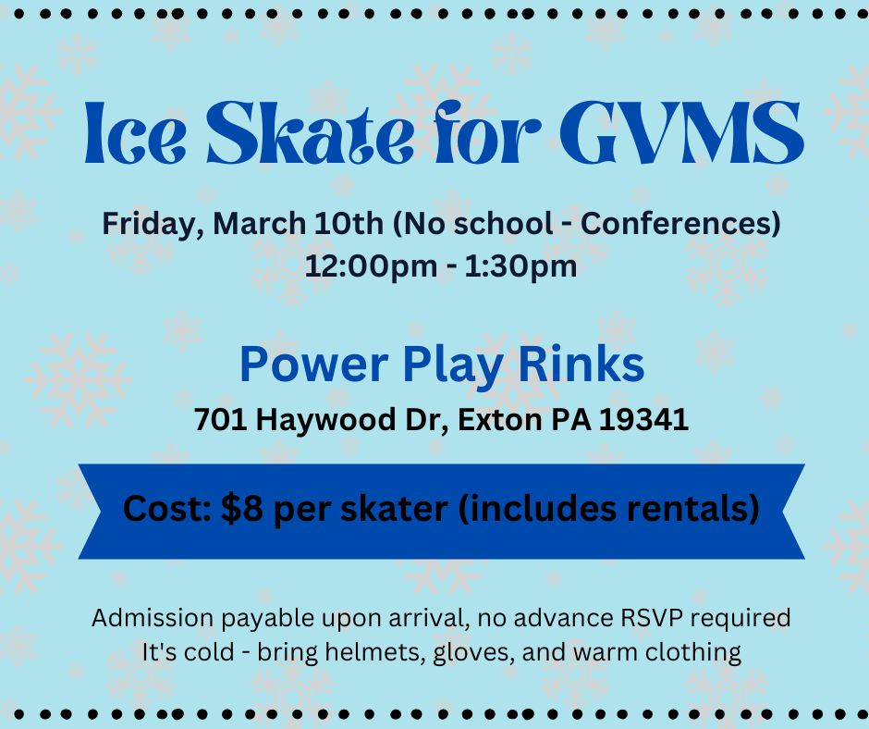
March Fundraisers
3/10- Ice Skate at Power Play Rinks
2/1- 3/31 Hershey Park Tickets
3/23 On the Border- Dine and Donate

Slide 9
Coming Soon: Stay Tuned
Phillies Tickets
People’s Light Tickets
Loot Goblin Scavenger Hunt
Dine & Donate at Boston Market

Slide 10
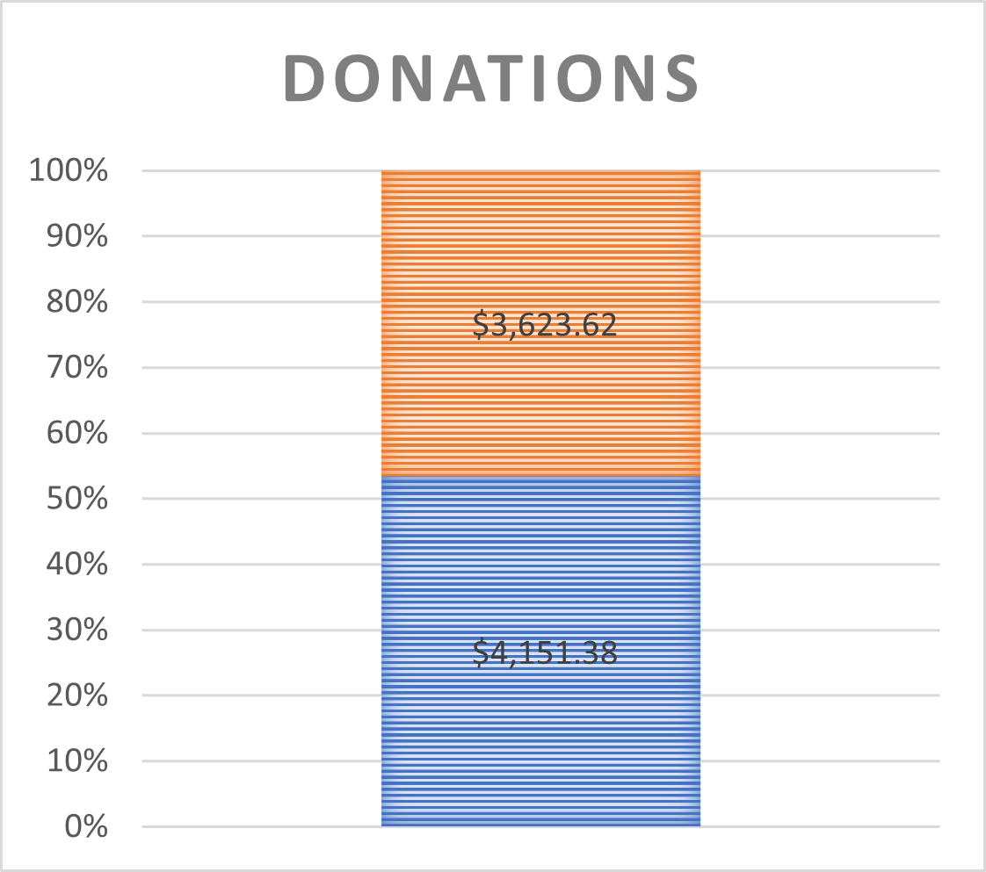
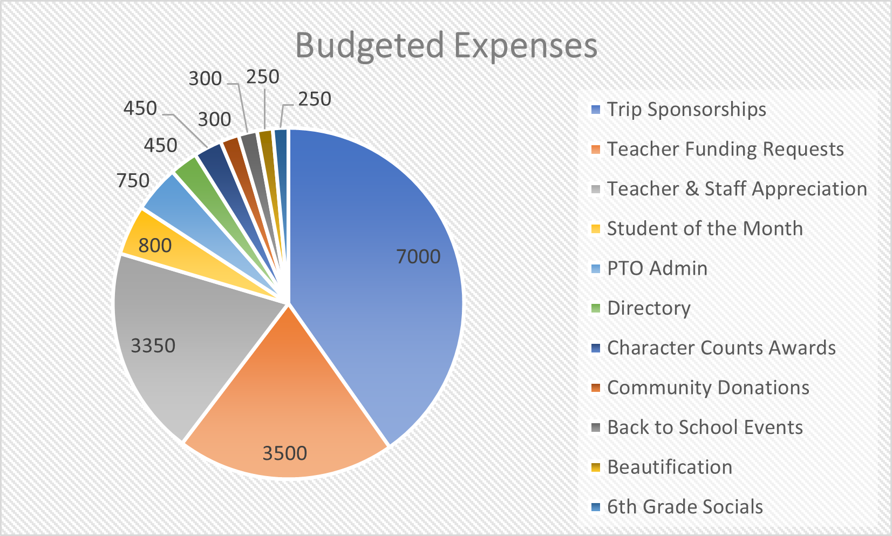
Budget Review

Slide 11
Conclusion
All of this information and more can be found on our website:
www.gvmspto.org
Follow GVMS PTO on Facebook!
Next General Meeting - May 4th at 1pm in GVMS Library
Thank you for coming and supporting GVMS!
Comments and Questions??

